Slide 1
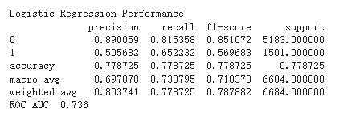
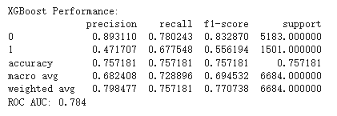
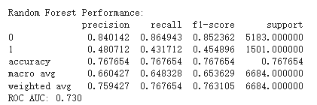
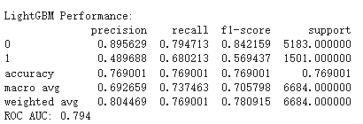
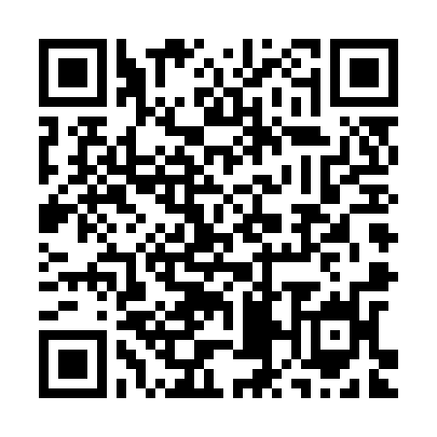

XX-000
Predicting User Churn in Music Streaming Services
Qiuyuan Zhang and Sharanya Dambe Vasudeva
Results
Fig.1 Classification Report for Logistic Regression, LightGBM, Random Forest and XGBoost
The results of this project highlight the effectiveness of machine learning in predicting customer churn and identifying the behavioral patterns that contribute to it. Four models were evaluated: Logistic Regression, XGBoost, Random Forest, and LightGBM.
Among these models,
LightGBM emerged as the top performer, achieving a **ROC AUC of 0.794**, which indicates a strong predictive capability. It attained a recall rate of 68% for churners, meaning it successfully identified the majority of users likely to cancel their subscriptions, while maintaining a precision rate of 49%.
Logistic Regression also performed well, with the highest overall F1-score of 0.787, making it a reliable option for balanced decision-making. The analysis revealed that key features such as `avg_listen` (average listening time), `sessions` (the frequency of user activity), and `cluster` (behavioral segmentation) significantly influence churn behavior.
Users with lower listening times and fewer sessions were more likely to churn, while clustering highlighted distinct user groups that could benefit from tailored retention strategies. Despite the strong performance of the models, challenges like class imbalance were evident, resulting in lower precision for predicting churners compared to retained users.
Addressing this issue through techniques such as SMOTE or cost-sensitive learning could further enhance model performance. These results provide actionable insights for businesses to design targeted retention strategies. For example, identifying high-risk users early allows for personalized interventions, such as offering incentives, curated content, or discounts to retain customers.
Additionally, real-time monitoring of engagement metrics can help trigger timely actions to prevent churn. Overall, this project demonstrates how data-driven approaches can empower businesses to effectively reduce customer attrition and improve long-term customer relationships.
Conclusions
Abstract
This project aims to predict customer churn for a music streaming service by analyzing user behavior and engagement patterns. By identifying users likely to cancel their subscriptions, the company can implement targeted retention strategies.
We utilize a dataset of 12.5 GB containing 26 million records with 18 features, including session durations, song preferences, demographics, and technical interactions. Users are segmented into behavioral clusters using Gaussian Mixture Models, and machine learning models such as LightGBM, XGBoost, and Random Forest are employed for churn prediction.
By analyzing engagement metrics and user patterns, we can identify churn risk profiles and reduce subscriber attrition in the competitive music streaming market.
This project identified key factors influencing customer churn, including average listening time, session counts, and user clustering. Machine learning models were used for predictions, with LightGBM achieving the highest ROC AUC of 0.794, while Logistic Regression had the best overall F1 score. Declining session counts and below-average listening times were significant churn indicators, enabling targeted retention strategies like personalized incentives for at-risk users. Future efforts should focus on addressing class imbalance to enhance precision and improve predictions for reducing customer attrition.
Introduction
In our project, "churn" refers to the user action of selecting "Confirm Cancellation" on the webpage. This project focuses on identifying the key factors that influence customer churn and using classification algorithms to predict whether a user will confirm the cancellation of the service. The customer churn dataset provided by IEEE DataPort contains user activity log information, which we aim to analyze in order to discover behavioral patterns and determine which factors contribute to a user's decision to cancel the service. We will apply methods such as feature selection, clustering, and machine learning to build a robust prediction model. The goal is to provide actionable insights for the business team to develop effective customer retention strategies.
Acknowledgments
We would like to express our sincere gratitude to Professor Bin Luo for his valuable guidance and encouragement throughout this project.
Contact Information
If you have any questions about this project, please feel free to contact the email address below:
qzhang12@students.kennesaw.edu
sdv1@students.kennesaw.edu
You can also scan the QR code below to learn more about the workflow of our project by viewing our code.
.
Research Question(s)
What behavioral patterns distinguish users who churn from those who stay?
How well can user interaction data predict future churn events?
Can unsupervised clustering reveal meaningful user segments with different churn risks?
Materials and Methods
We started using logistic regression for feature selection. After identifying the features, we believed to be valuable for the overall model, we applied Gaussian Mixture Models (GMM) clustering using our dependent variable as a reference to segment the data. The resulting cluster labels were then added as a new independent variable for subsequent prediction. For modeling, we ultimately chose logistic regression as the baseline model then included LightGBM, Random Forest, and XGBoost for comparison to predict "cancellation confirmation."
References
https://ieeexplore.ieee.org/document/10530632

